Slide 1
Processing JSON-LD using 3 favorite languages
Lupu Cosmin Viorel
Maftei Ervin
Plătică Alexandru-Gabriel

Slide 2
What is JSON-LD (JavaScript Object Notation for Linked Data)
is a method of encoding linked data using JSON;
requires as little effort as possible from developers to transform their existing JSON to JSON-LD;
allows data to be serialized in a way that is similar to traditional JSON;

Slide 3
Uses for JSON-LD
search engine optimization activities;
Biomedical Informatics;
representing provenance information;
basis of Activity Streams;
context of Internet of things(IoT)
Notes:
where a Thing Description,] which is a JSON-LD document, describes the network facing interfaces of IoT devices.

Slide 4
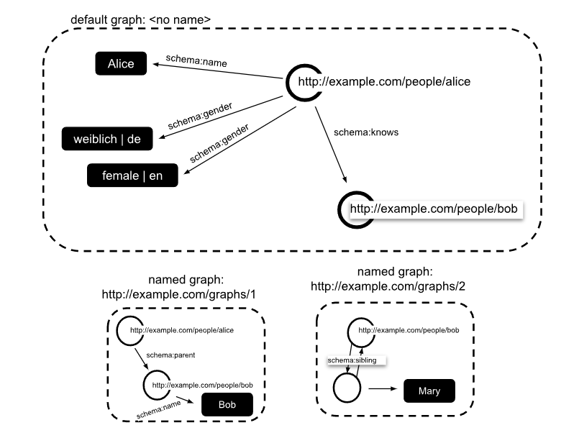
Structure

Slide 5
DEMO

